Slide 1
COMP90054 AI Planning for Autonomy Workshop Week6

Slide 2
Objectives
Delete Relaxation
Relationship between h*, h⁺, h^{add}, h^{max}, h^{FF}
How to compute h^{add}
How to compute h^{max}

Slide 3
relaxation
approximate
h_{gc}
h*
h_{pre&del}
relaxation
relaxation
H_{man_closed}
h_{man}
H_{man_furthest}
h_{gc} is the goal count heuristic
h_{gc} is not admissible
h_{pre&del} is admissible,
Such as G={p_1,p_2}
h_gc=2
h*=1 when O_add={p_1, p_2}

Slide 4

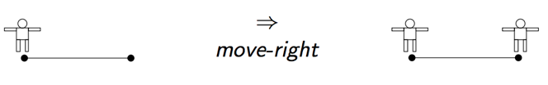

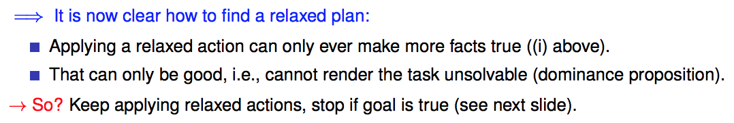
Delete Relaxation
Greedy Relaxed Planning

Slide 5
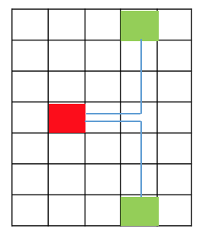
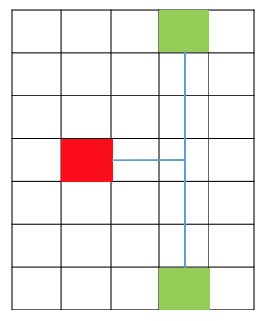
How would delete relaxation be interpreted in Pacman?
If computed with respect to each food it’s roughly a Minimum Spanning Tree (technically a Steiner Tree, since paths can branch in non-food location, i.e. the Steiner Points)
Minimum Spanning Tree
Steiner Tree

Slide 6

Relationship between h*, h⁺, h^{add}, h^{max}, h^{FF}
h*
h^{add} or h^{max}
estimate
approximate
h
(h⁺)
Extract a relaxed plan
To compute h^{FF}
approximate
h^{FF}
h⁺: is the optimal delete relaxation heuristic
But h+ is hard to compute

Slide 7
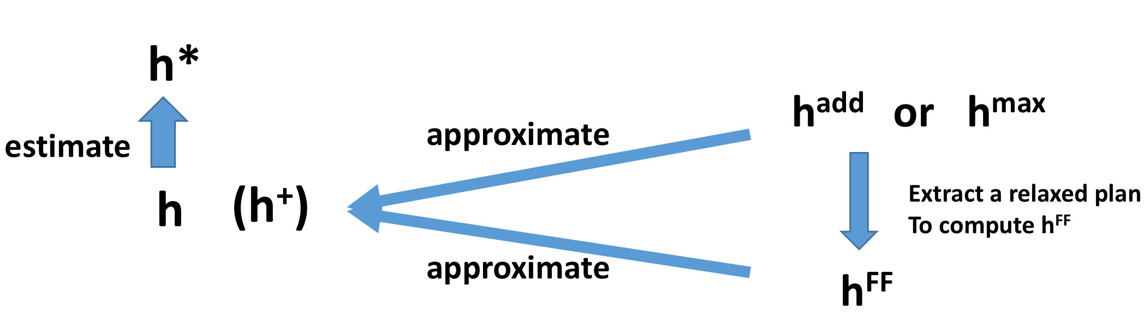
h⁺ is the optimal delete relaxation heuristic
h⁺ is admissible, so h⁺ <= h*
h^{max} is admissible h^{max} <= h*
but far too optimistic. h^{max} is too small. h^{max} <=h⁺
To sum up, h^{max} <= h⁺ <= h*
h^{add} is not admissible(so h^{add} can be larger than h* in some cases)
It is pessimistic. h^{add} overcounts. h^{add} >= h⁺
The properties of h^{FF} is similar with h^{add}, but h^{FF} won’t overcount

Slide 8
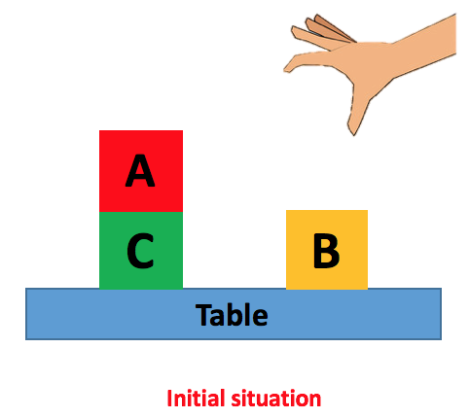
Domain Independent heuristic
Not specific to one problem.
e.g. delete relaxation, goal-counting
Manhattan distance

Slide 9
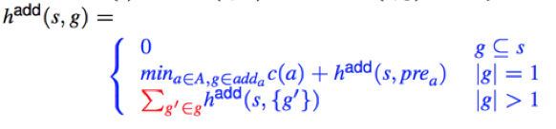
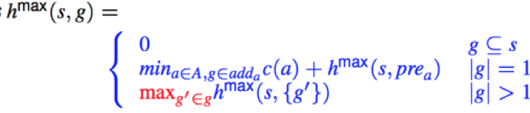
Bellman-Ford Algorithm
How to compute h^{add}
Recursive
Assumption: each goal can be achieved independently
How to compute h^{max}

Slide 10
Bellman-Ford Algorithm
How to compute h^{add}
Recursive
Assumption: each goal can be achieved independently
How to compute h^{max}

Slide 11
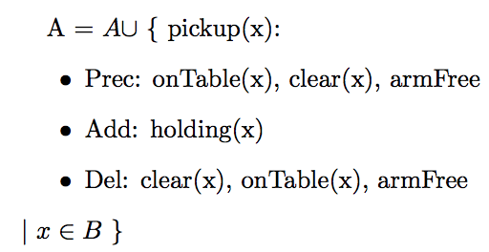
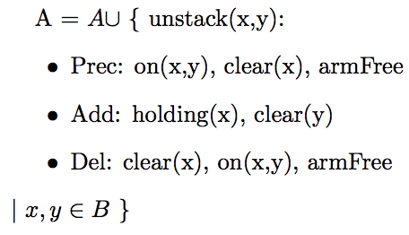
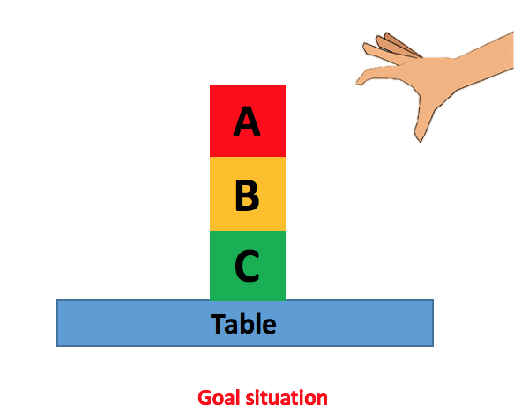
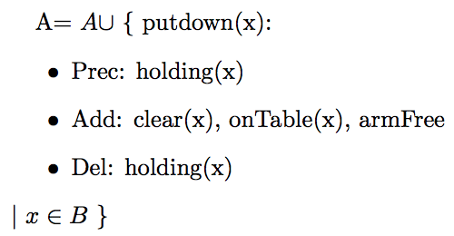
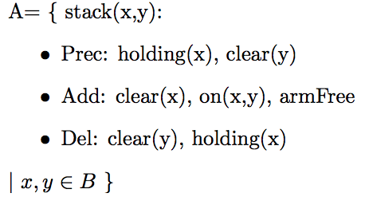
A blocks-world problem – 4 actions
Assume the cost of each action is 1

Slide 12







How to compute h^{add}
 | Cl(A) | Cl(B) | Cl(C) | onT(A) | onT(B) | onT(C) | On(A,B) | On(A,C) | On(B,C) | H(A) | H(B) | H(C) | ArmFree
0
1
2
3
0
0
$$∞$$
$$∞$$
0
0
$$∞$$
0
$$∞$$
$$∞$$
$$∞$$
$$∞$$
0
Initial Situation :
I = {on(A,C), onTable(C), onTable(B), clear(A), clear(B), armFree}
Cl(A)means Clear(A)
onT(A) means onTable(A)
H(A) means holding(A)

Slide 13
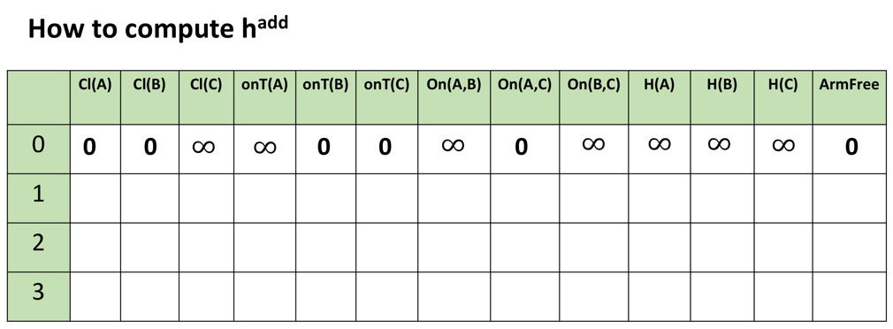
0
0
0
0
0
0

Slide 14
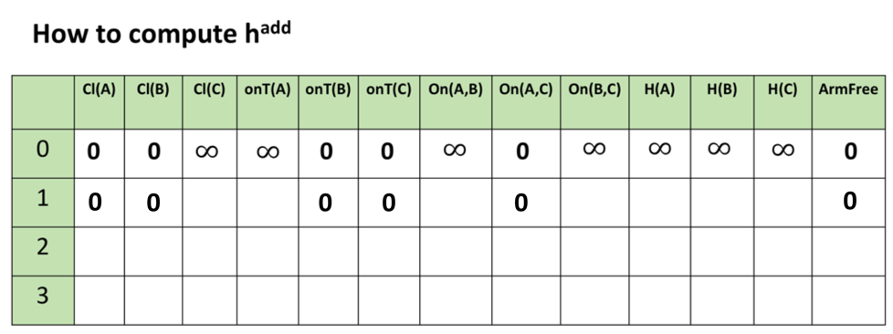
What (one) action can make clear(C) True?

Slide 15
A blocks-world problem – 4 actions

Slide 16
1
What (one) action can make clear(C) True?
unstack(A,C), unstack(B,C), putdown(C), stack(C,A), stack(C,B)

Slide 17
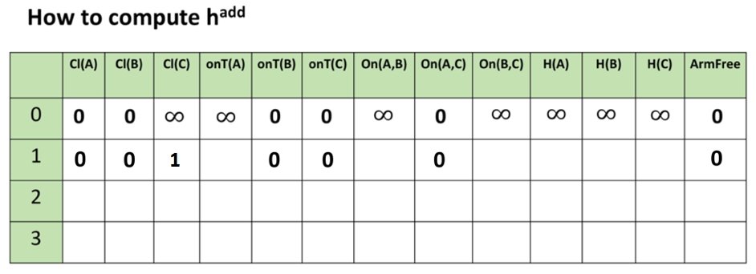



$$∞$$
What (one) action can make onTable(A) True?
Preconditions:
holding(A)
putdown(A)
$$∞$$
1
+
$$∞$$
=

Slide 18
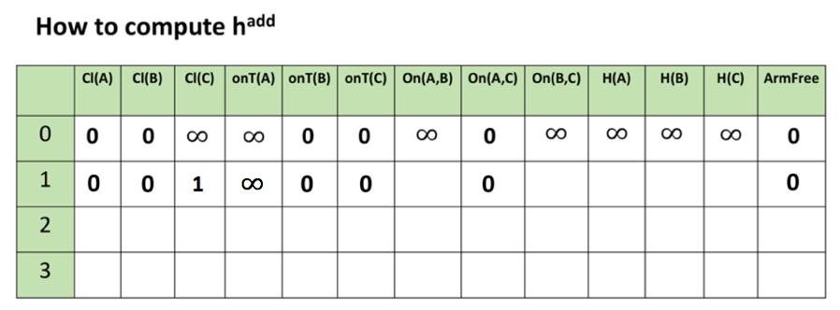



$$∞$$
$$∞$$
1
1
$$∞$$

Slide 19
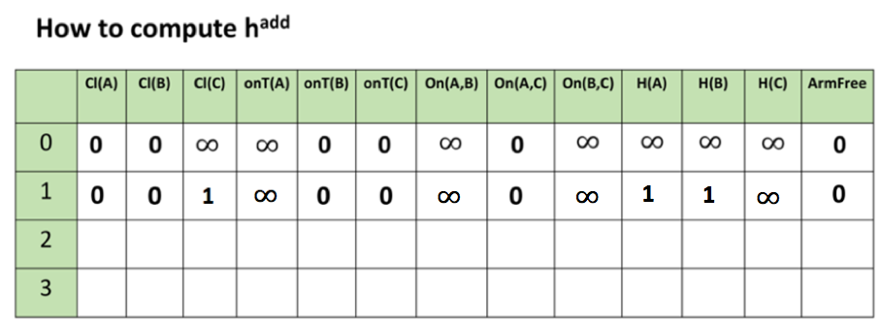

0
0
1
2
0
0
0
1
1
0
What (one) action can make onTable(A) True?
Preconditions:
holding(A)
putdown(A)
=
2
1
+
$$1$$

Slide 20
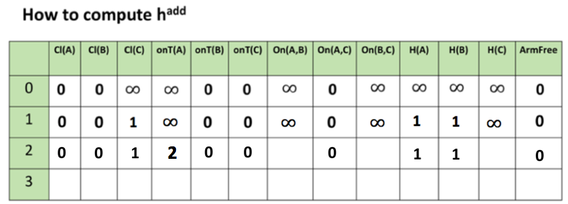
2
3(2)
2
add(max)
What (one) action can make on(B,C) True?
Preconditions:
holding(B)
clear(C)
1
stack(B,C)
h^{add} = 3
h^{max}=2
1
1

Slide 21
add(max)
2
3(2)
2
After we have get all the values in iteration 2. We shouldn't stop.
When to stop?
Converge
When the values of last two iteration are exactly the same

Slide 22
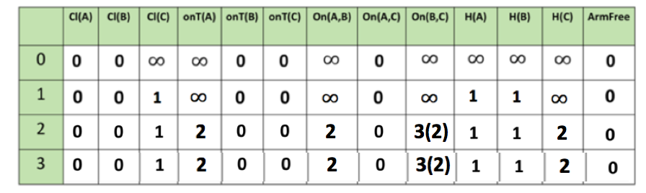
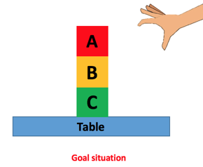
Last Step: Get h^{add} or h^{max}
add(max)
|G| = 4
> 1
h^{add} (I) = sum(0, 2, 3, 0) = 5
approximate
h+
h^{max} (I) = max(0, 2, 2, 0)= 2

Slide 23
